Slide 1
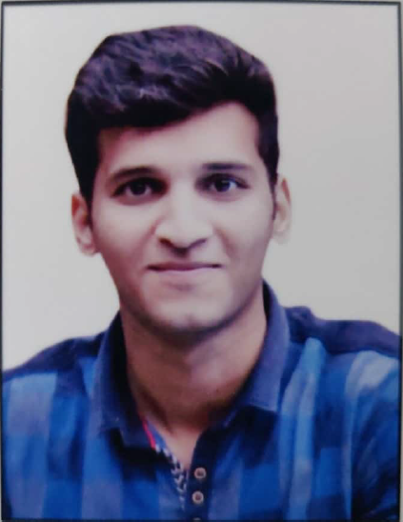

Skills
CIF, Boomi
Agile Development
APIGEE
Testing Tools
JSP,XML, JSON, REST.
Competencies
Have thorough understanding of Integration Principles and Designs for Boomi and APIGEE. Ability to comprehend the Business Requirement, Design and proficient in using Atomsphere & APIGEE Edge Platform to discover, consume, build, deploy, manage, and govern APIs. Well versed with Boomi and APIGEE Integration Best Practices. Analytical mindset and problem solving skills. Good communication skills and effective team player. Having Knowledge on Spring framework as well as MySQL, PostgreSQL databases. Worked on redevelopment of CIF framework. AWS Level-0 Certified(Migration Ambassador Foundations). Agile Software Development Certified. Professional Integration Developer Boomi Certified.
Name Rohan Said
Title Analyst
Location Mumbai, India
Basic JAVA, MS SQL, PostgreSQL, Spring MVC.
Boomi Specifics
Boomi Connectors
Web Services
Atom Management
Web Technologies
Exception Handing
Deployment
Apigee Specifics
API Products
API Proxies
Apps
API Design & Security
Analytics & Logging
Integration Experience
Working knowledge of various Traffic management, Security, Mediation, Extention policies via APIGEE like ‘Quota’, ‘Spike arrest’, ‘OAuth2.0’, ‘VerifyAPI Key’, ‘Assign message', 'Extract Variables’ and ‘JavaScript’. Working knowledge of exception handling and logging, in Boomi and APIGEE distributed environment. Used Data transformations to handle diverse set of message formats like JSON, XML, CSV, etc. and have worked on various shapes like map, message, Notify, Process call, Route, Mail in boomi. Working knowledge of creating API proxies, API Products and Apps and impementing various policies in proxies. Developing Entities and services in spring boot. Developing spring boot microservices. Worked on understanding the existing CIF in spring MVC and redeveloping it on spring boot framework. Currently working on client side project on CIF framework.

